Slide 1

CRYPTO TRACKER
SHAPING THE FUTURE THROUGH SMART SOLUTIONS TODAY
GROUP MEMBERS:
1. CHINTSOGT – 113021194 (LEADER)
2. KHANGAI – 113021187
HTTPS://GITHUB.COM/CHINTSOGT0825/FINAL.GIT

Slide 2



OVERVIEW
Our project implements a real-time cryptocurrency tracking and prediction dashboard using advanced Python features and libraries:
● ZENOH FOR REAL-TIME PUB/SUB MESSAGING
● Dash/Plotly for interactive web visualization
● Scikit-learn for linear regression price prediction
● BeautifulSoup for news scraping
● Threading for concurrent data collection
● Pandas for data processing

Slide 3

KEY ACHIEVEMENTS
● REAL-TIME PRICE UPDATES FROM COINGECKO API
● 24-hour price predictions with confidence intervals
● Interactive historical price charts
● Automated news aggregation
● CSV data logging for analysis

Slide 4


CHAPTER 2: IMPLEMENTATION
CORE ARCHITECTURE

Slide 5
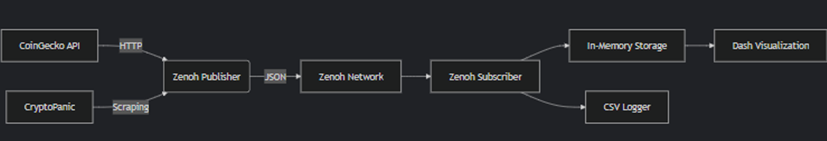
SYSTEM DESIGN
The application follows a multi-threaded producer-consumer pattern:
● PUBLISHER THREAD: FETCHES PRICES/NEWS EVERY 10S → ZENOH
● Subscriber Thread: Listens to Zenoh → Updates memory/CSV
● Dash Main Thread: Handles UI rendering
DATA FLOW

Slide 6

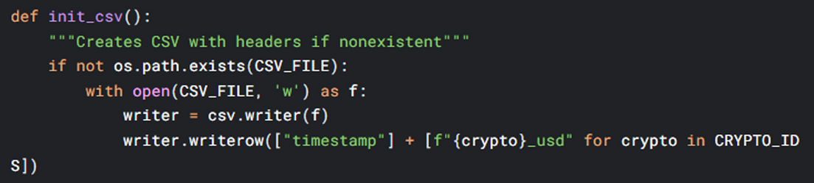
FIELDS
METHODS
● CSV_FILE: Path for price history storage
● ZENOH_PRICE_KEY: Pub/sub channel for price data
● CRYPTO_IDS: Supported cryptocurrencies
● fetch_prices(): Gets current prices from CoinGecko API
● fetch_crypto_news(): Scrapes headlines from CryptoPanic
● append_to_csv(): Logs prices with timestamps
DATA COLLECTION SYSTEM
FUNCTIONS

Slide 7

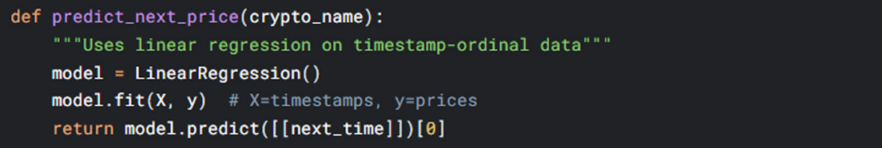
MODULE: PREDICTION ENGINE
FIELDS
● PRICE_HISTORY: DEQUE STORING LAST 10-100 PRICE POINTS
● prediction_history: Stores prediction results
METHODS
FUNCTIONS
DATA CLEANING HANDLES:
Invalid timestamps via pd.to_datetime(errors='coerce')
Outliers through value range filters

Slide 8
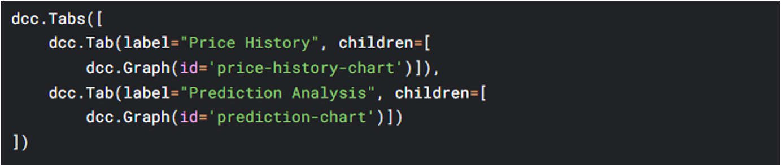
INTERACTIVE ELEMENTS
VISUALIZATION DASHBOARD
Key Components:
1. Real-time Price Chart
a. Displays last N points (configurable via slider)
b. Color-coded percentage changes
2. Prediction Tab
a. 24-hour forecast with confidence bands
b. Hourly prediction table with trend indicators
3. News Aggregator
a. Displays top 4 news items with links

Slide 9


CHAPTER 3: RESULTS

Slide 10
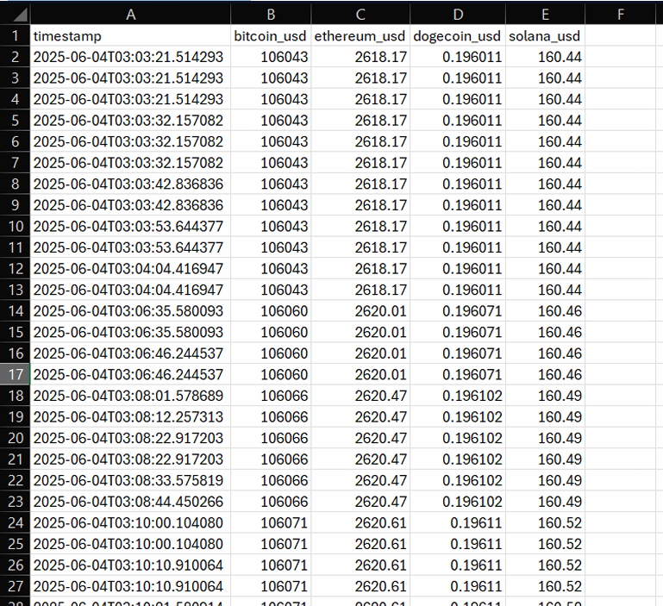
REAL-TIME DATA COLLECTION
● SUCCESSFULLY SUBSCRIBED AND RECEIVED PRICE UPDATES FROM THE ZENOH PUBLISHER.
● Stored up to 2400 historical price points per coin in memory and CSV.

Slide 11
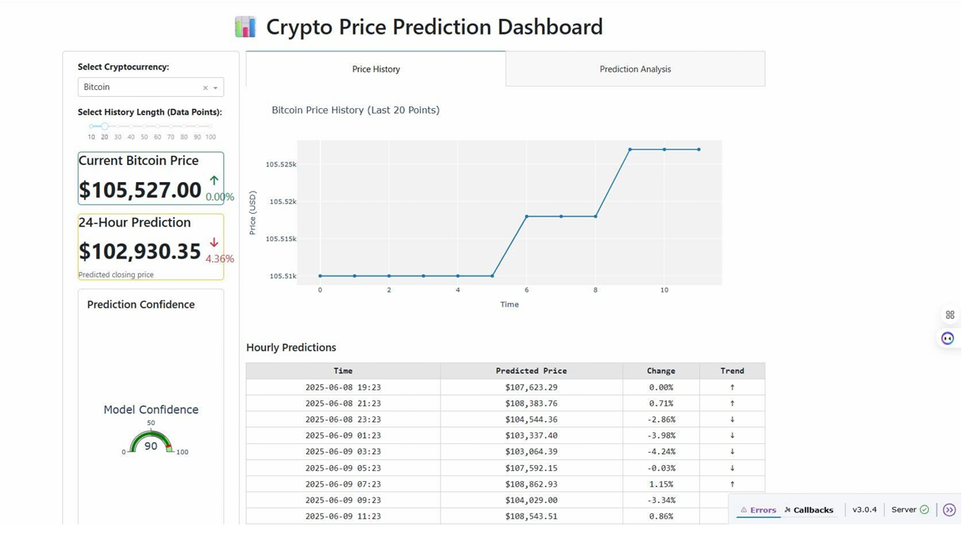
VISUALIZATION
● INTERACTIVE LINE CHARTS SHOW PRICE HISTORY AND 24-HOUR FORECASTS.
● Dashboard updates every minute with fresh data.
● Confidence gauge indicates model prediction reliability.
● The prediction table provides hourly forecast summaries with intuitive trend
arrows.

Slide 12
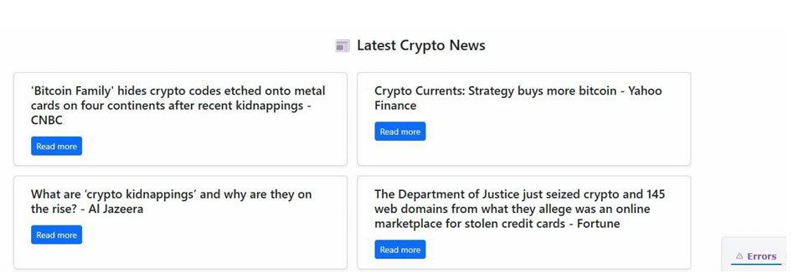
NEWS INTEGRATION
● RELEVANT NEWS HEADLINES FOR SELECTED CRYPTOCURRENCY ARE FETCHED LIVE FROM GOOGLE
News RSS.
● News section updates dynamically based on the selected coin.

Slide 13
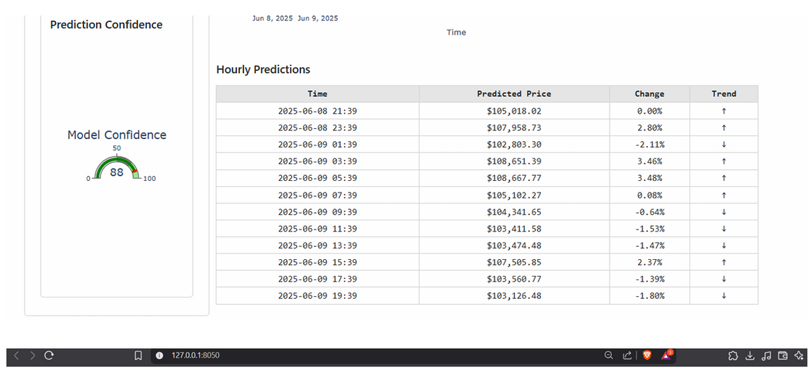
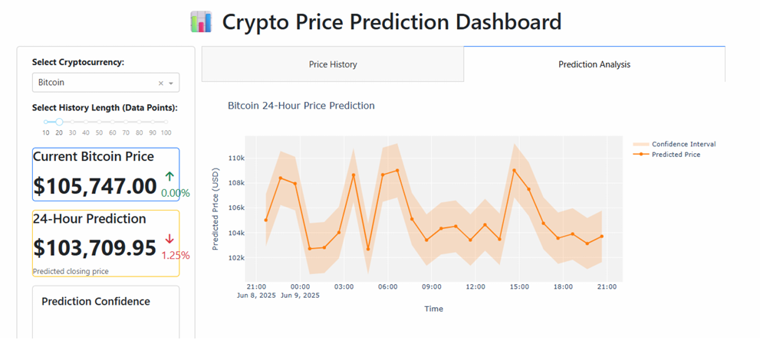
PREDICTION PERFORMANCE
● GENERATES 24-HOUR FORECASTS WITH ±2% CONFIDENCE INTERVALS
● Handles missing data gracefully with defaults

Slide 14
CHAPTER 4: CONCLUSIONS
The project demonstrates an effective integration of real-time data streaming, web visualization, and synthetic forecasting for cryptocurrency prices. Using Python’s rich ecosystem—Zenoh for messaging, Dash for UI, and Beautiful Soup for web scraping—enabled rapid development of a functional dashboard. While the prediction model is simple, it provides valuable insights and a foundation for future enhancements such as machine learning-based forecasting and more comprehensive data persistence. The project is modular and extensible, ready to incorporate additional features like more coins, advanced models, user management, and database-backed storage.

Slide 15

THANK YOU

